Slide 1
Fulfillment of physical education courses
University of Pannonia
Institute of Physical Education and Sports
Usage of PETE system

Slide 2
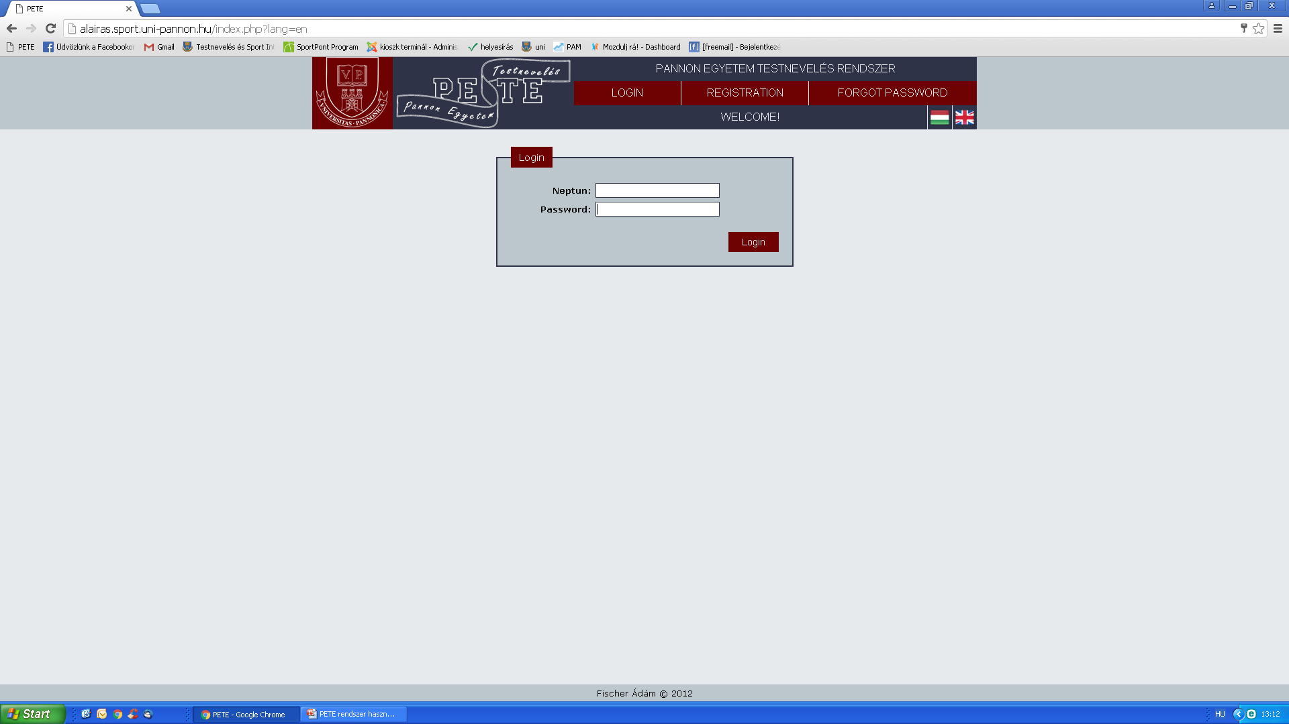
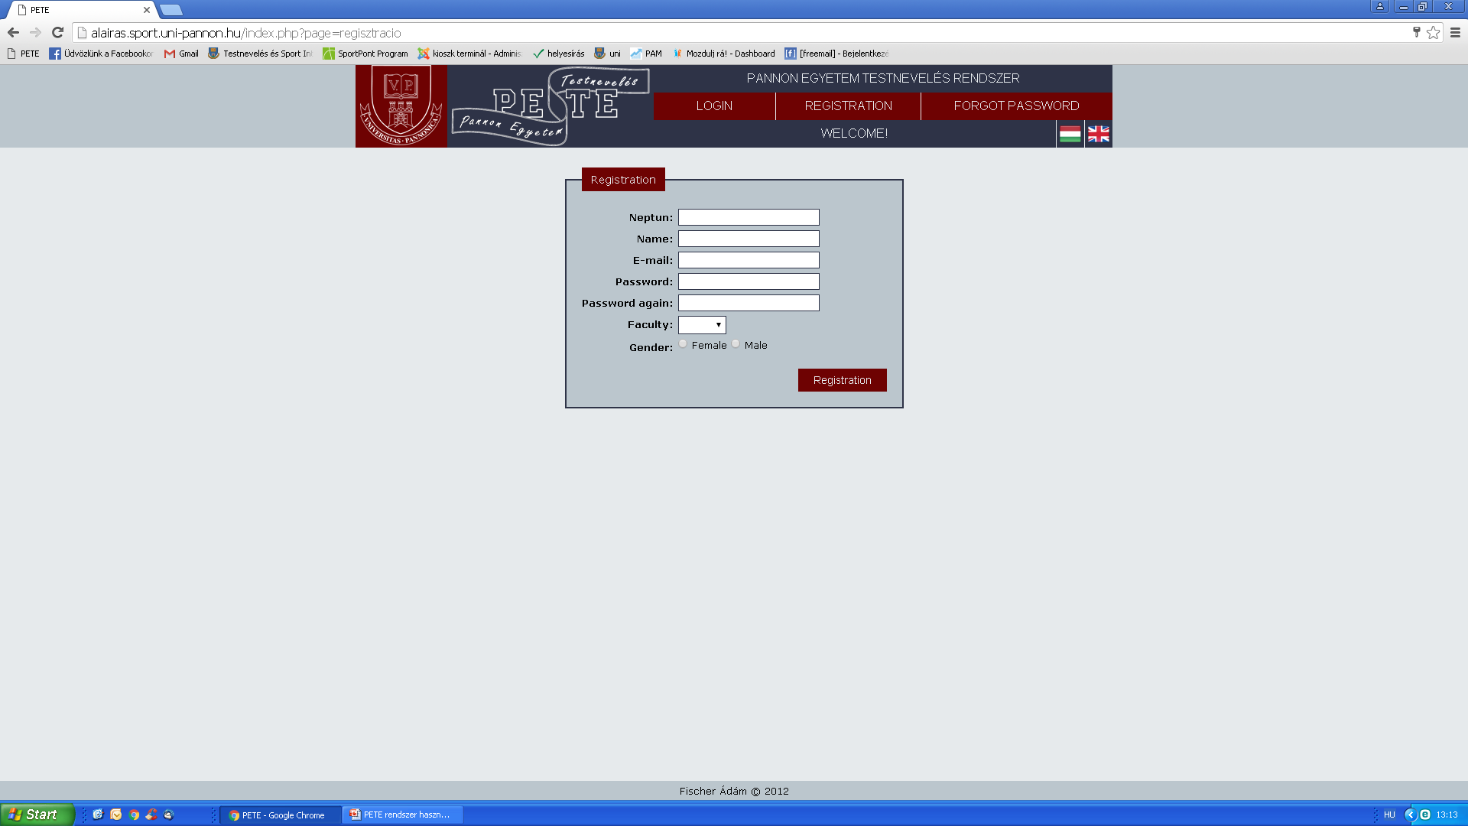
Register on http://alairas.sport.uni-pannon.hu/index.php
Activate your account by adding your personal data
PETE
University of Pannonia

Slide 3
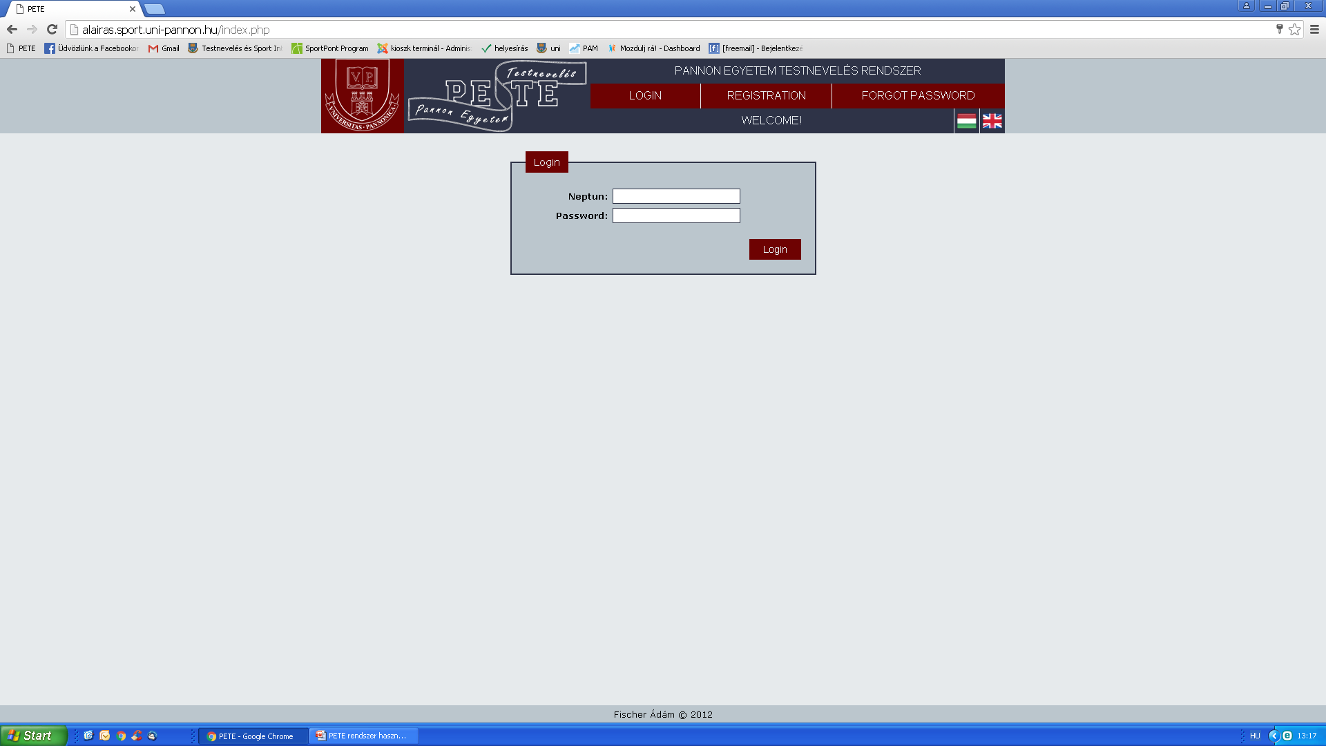
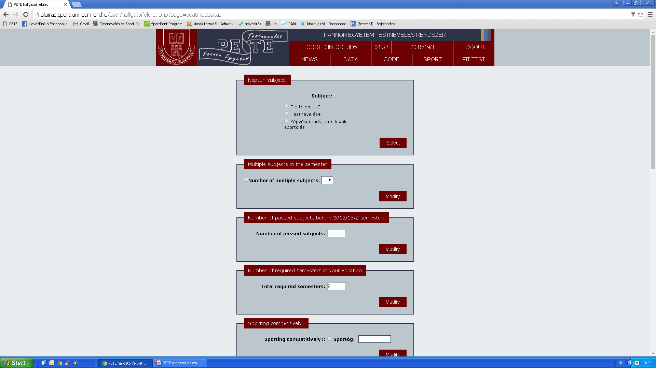
3. You have to take the course (I.- IV.) each semester.

Slide 4
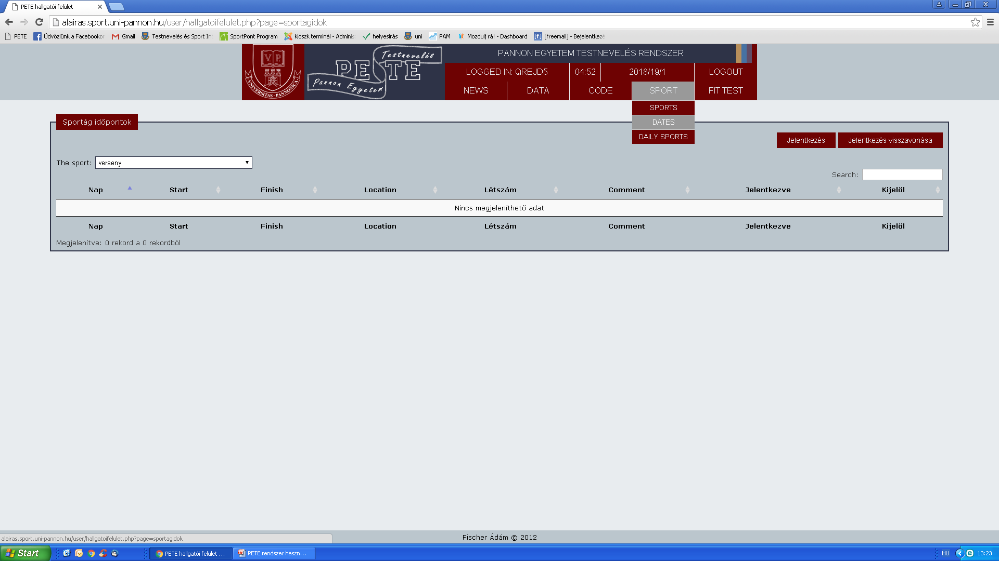
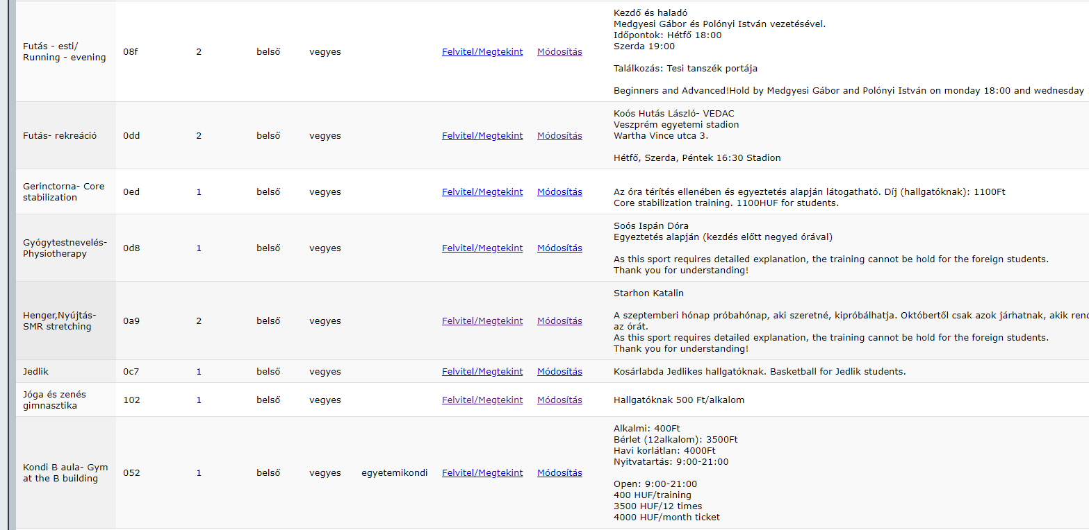
4. Clicking on SPORT menu You can choose from several sports
5. Most of the courses can be taken after registering for the particular sport
5. 20 signatures need to be collected during the semester, which will be given to you at the end of each course
6. The signatures need to be uploaded at the PETE system

Slide 5
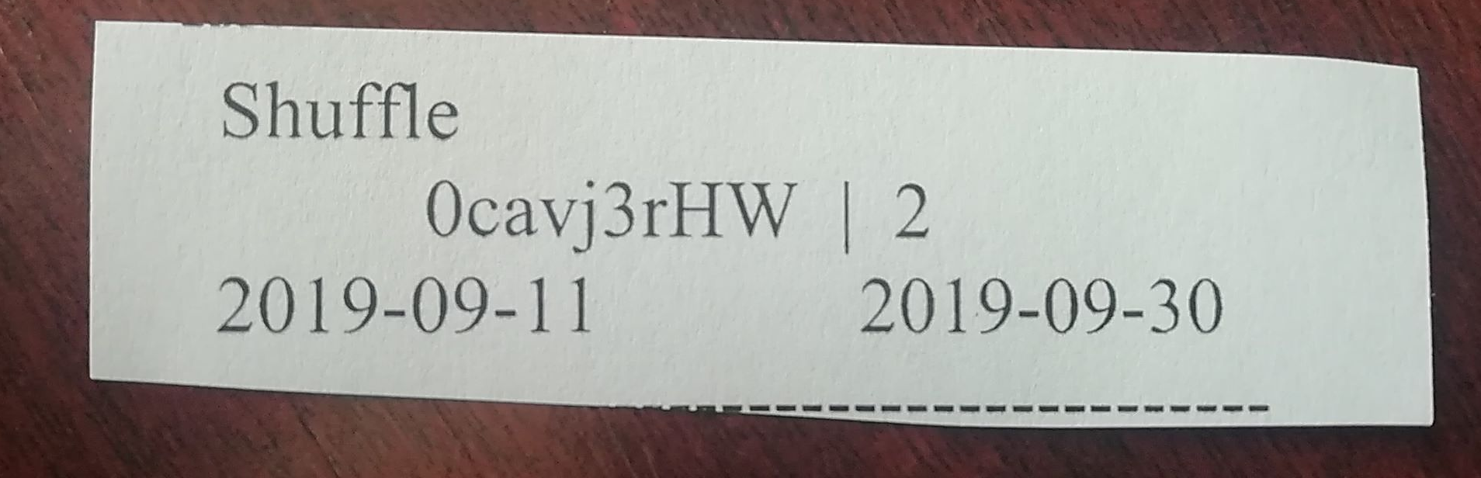
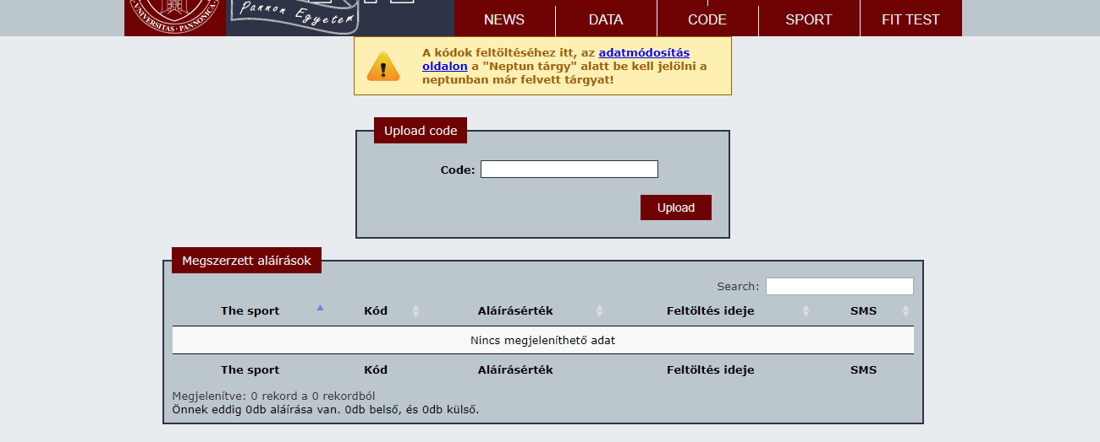

Slide 6
Important to know…
Compulsory semesters
BA: 4 semesters
MSC: 2 semesters
Exempting from physical education
After consultation with the director of the department
Fulfillment of several PEs during 1 semester
Permitted, after reconcilation

Slide 7
WARNING
The ultimate condition of accepting physical education is to take the course of PHYSICAL EDUCATION in Neptun system!

Slide 8
Thank you for your attention!
Quetions?

